Slide 1
Contracts Advance Webinar
“How do you write a winning bid?”
Thursday 24th November 2022
Matt Mitchell and Rob Ward

Slide 2
Introduction & Housekeeping
A discussion training session
Your participation
Our insights and experience

Slide 3
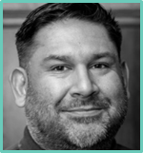
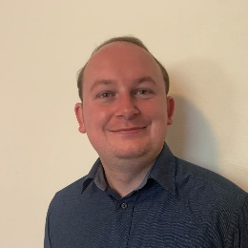
Matt Mitchell & Robert Ward
Matt has over 25 years of bidding experience with considerable managerial expertise in corporate and operational services. Matt has supported CA and our clients to project manage a multitude of bids in industries ranging from; defence, healthcare, print, FM and many more. Matt has previously held a number of senior roles including Director of Development and is the Head of Advisory at CA.
Rob is a bid professional with over 14 years’ experience, working across writing and management positions, and delivering successful bids in multiple industries. Rob has worked on over 100 bids across a variety of service lines, and has experience in bid writing for organisations of all sizes and maturities. Rob is a Senior Bid Writer at CA, and has supported CA to achieve their bid win rate of over 85%.

Slide 4
The 7-stage Bid Management Process
1) Pre-bid Activity
- Future bid pipeline creation
- Pre-bid customer engagement
- Qualification & Requalification
- Bid Ready
2) Bid ‘Kick Off & Strategy’ Session
- Getting stakeholders together with complete buy-in
- Agree roles and responsibilities
- Project timelines and approach
- Key win themes and USPs
- Produce executive summary
- Requalify
Stage 7
Stage 1
3) The Financial Modelling/Product Pricing
- Run in parallel to the production of the bid
- Turn an Achilles Heel into a service strength
- Ask clarification questions and adapt
- Requalify
4) Bid Response Production
- Workshop sessions
- 2-3 draft versions
- The 5 key elements of the Bid response
- Combining skill-sets
- Requalify
5) The Mid-Bid Review
- Ensure the bid project is on track
- Ensure all key actions are being managed
- Agree solutions to any issues
- Agree if the project should proceed
- Requalify
7) Bid Sign Off & Continuous Process Improvement
6) Final review of bid before submission
- Review each draft and the executive summary
- Recommendations to be implemented
- Use the scoring system
- Finalise before final sign off

Slide 5
Stage 4: Response Production

Slide 6
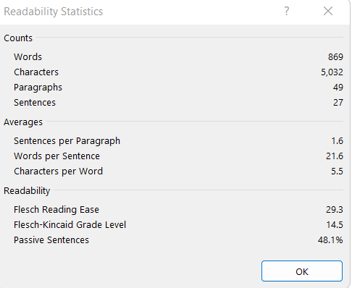
How to create a compelling bid response (Guidance)
25/50/25 rule – Plan, Draft (2-3), Review
Existing information: previous content(!), reports, policies, testimonials
Shorter sentence length is easier to read (InsideGovUK blog)
14-word sentence = 90% understanding
>43 words = 10% understanding
Reading statistics in MS Word
Flesch Reading Ease (1 and 100)
Flesch-Kincaid Grade Level (US grade level of education)
% passive sentences

Slide 7
How to plan a response
Link back to your Bid Strategy and pre-bid work
Read and understand the question and what is really being asked
Structure the response to mirror the question – Exam question approach
Sketch out an outline answer with supporting notes of what will be needed
Sense check with Bid Manager
Note what is needed for capture sessions

Slide 8
How to run a capture session
Plan out the response first
– structure, info requests, word limits/format
Capture workshops with SMEs, PM and writer(s)
Thinking time
What does the customer want?
How will you deliver it? (linked to the spec, win themes & benefits)

Slide 9
How to create a compelling bid response (5 elements)
Acknowledge the question and set the scene of the response
Your organisation’s experience
Provide examples that relate to the specification
Offer evidence of your experience
Demonstrate clearly how you will deliver client benefit and sustainable value add
Weave in: win themes, differentiation, USP’s!

Slide 10
WHWW
For every sub-section/paragraph you write, consider the following methodology:
WHAT you are going to do
HOW you are going to do it
WHY you are going to do it – the benefit
WHEN you have done it before – experience/evidence/examples

Slide 11
The 3 draft process
Information gathering
Draft 1 – rough cut, focus on structure – What, How, Why?
Draft 2 – fill most gaps and ensure substance to responses – compliant bid!!
Draft 3 – polish and maximise marks
Realistic timescales for review: 1-2 days per review
Ensure the sequencing and coordination of review is efficient – no duplication/multiple copies

Slide 12
Play to your strengths
Manage SME’s expectation and behaviours
Send information to the writer in the best format if possible
Line up reviewers who will be critical within the business and review in-line with the scoring and evaluation methodology
PMs to enforce the timescales and multiple draft process
Bid Writers focus on writing content

Slide 13
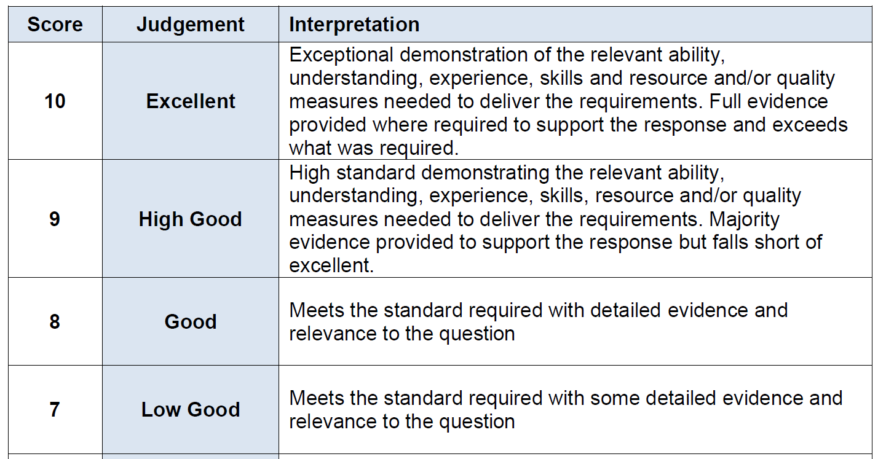
Example Scoring
STATE THE OBVIOUS!!!!!

Slide 14
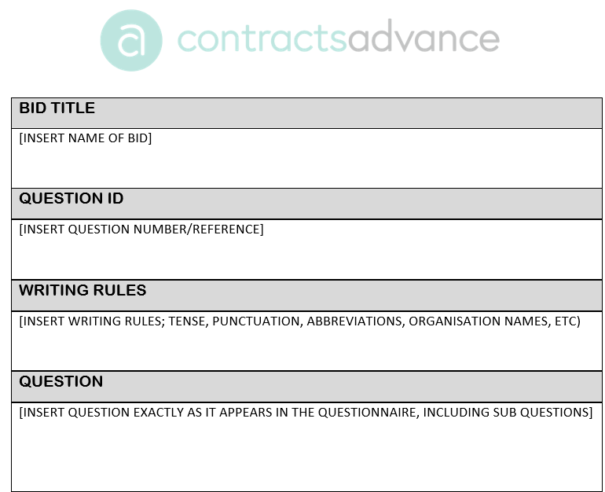
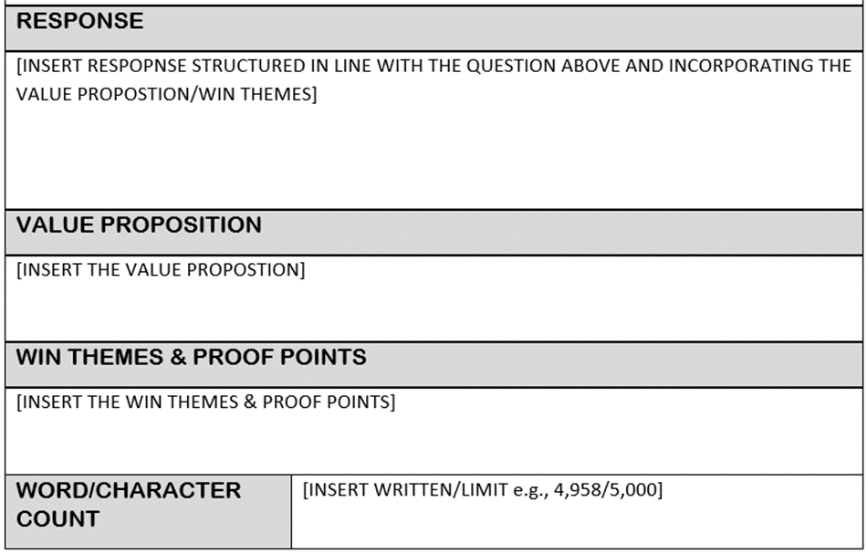
Response Template

Slide 15
Summary & Final Message

